Slide 1
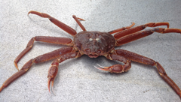
2024-05 Tanner Crab Report
William Stockhausen
AFSC/NMFS/NOAA
May 21, 2024

Slide 2
Outline
New Data and Analysis
Proposed Models
TCSAM02 models
GMACS models
Summary

Slide 3
SSC/CPT Requests Addressed
Develop GMACS model that matches current assessment model
Compare “successful” and “unsuccessful” cohorts

Slide 4
New Analysis
Comparison with NMFS EBS survey results from “crabpack”
VAST (model-based) size compositions
Small crab “success”

Slide 5
Progress toward a GMACS model for Tanner crab
Lots of progress
what??
Still a ways to go
what??
Notes:
2022

Slide 6
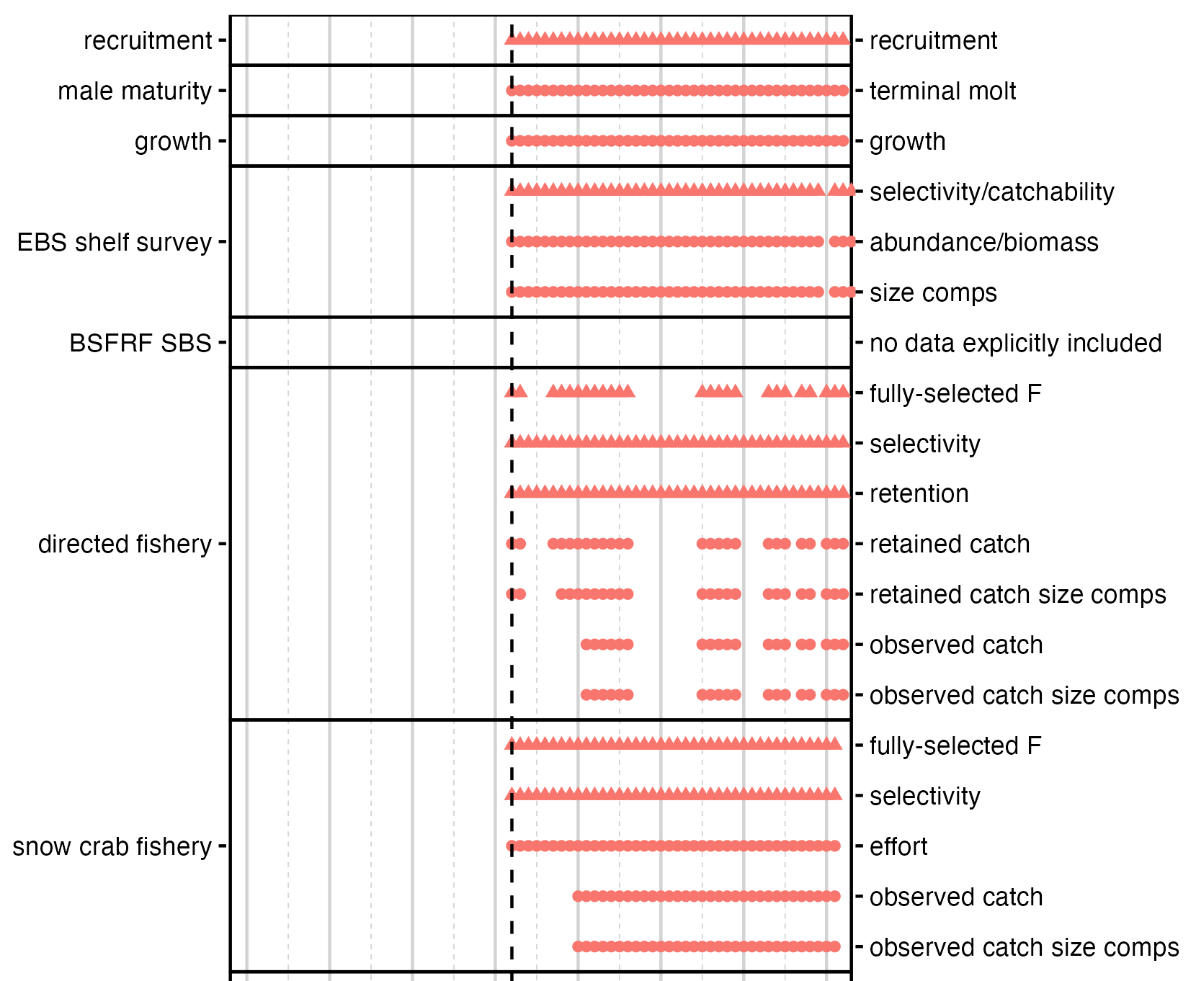
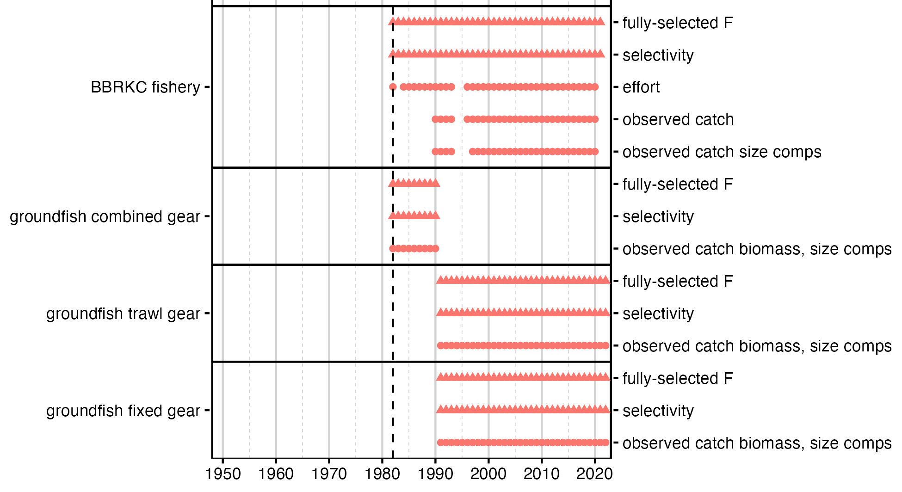
May2024: simplified GMACS model
Notes:
2022

Slide 7
Assessment model (22.03b) time frames and data
Notes:
2022

Slide 8
Assessment time frames: model processes
Notes:
updated 2024

Slide 9
Population dynamics
Notes:
2025

Slide 10
Fisheries
Notes:
2025

Slide 11
Fisheries
Notes:
2025

Slide 12
Surveys
Notes:
2025

Slide 13
Likelihoods
Penalties??
Notes:
2022

Slide 14
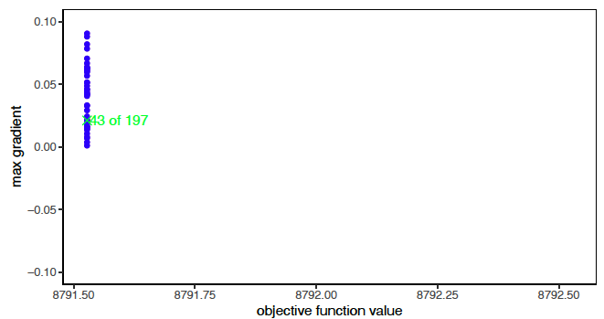
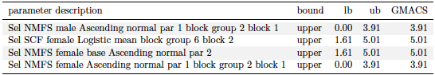
GMACS Models
Notes:
2022

Slide 15
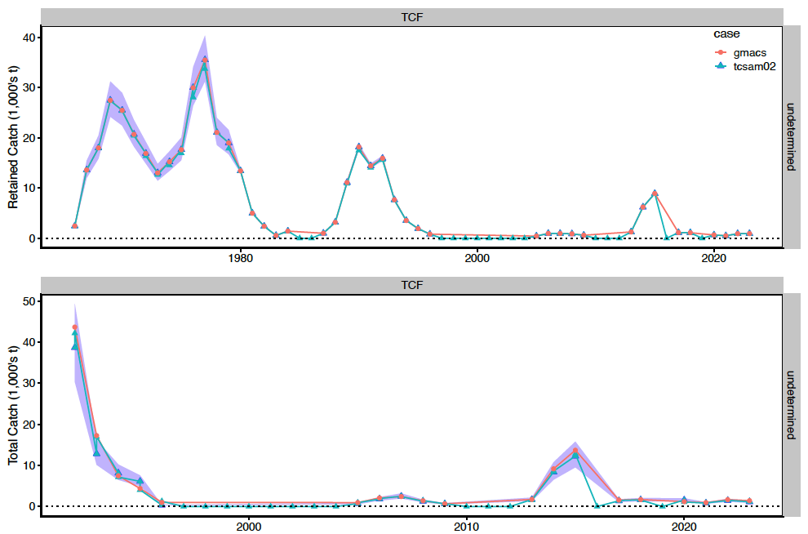
GMACS Models
Notes:
Fits to retained (upper) and total (lower) catch in the directed fishery.

Slide 16
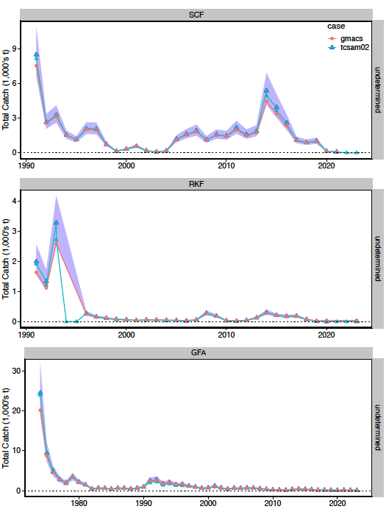
GMACS Models
Notes:
2022

Slide 17
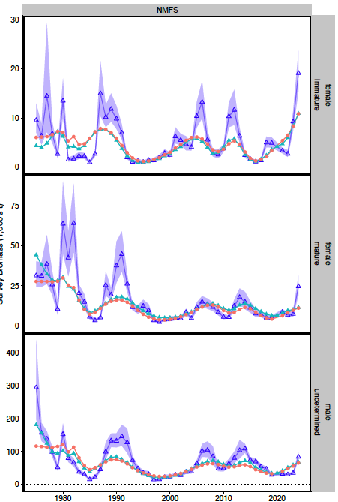
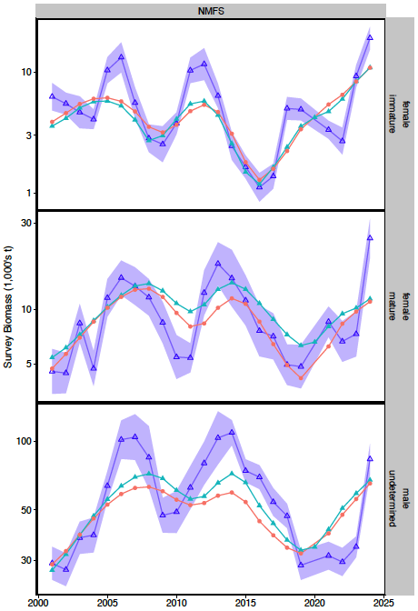
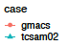
GMACS Models
Notes:
2022

Slide 18
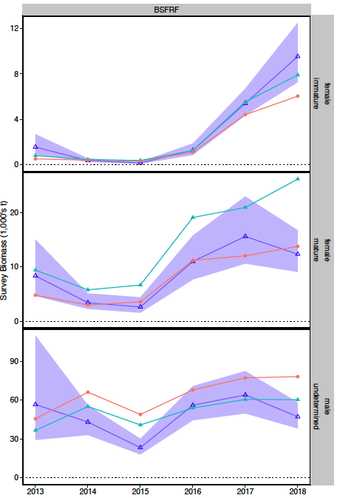
GMACS Models
Notes:
2022

Slide 19
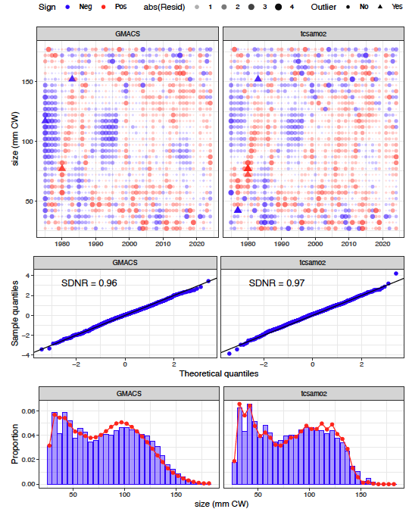
GMACS Models
Males
Notes:
NMFS survey

Slide 20
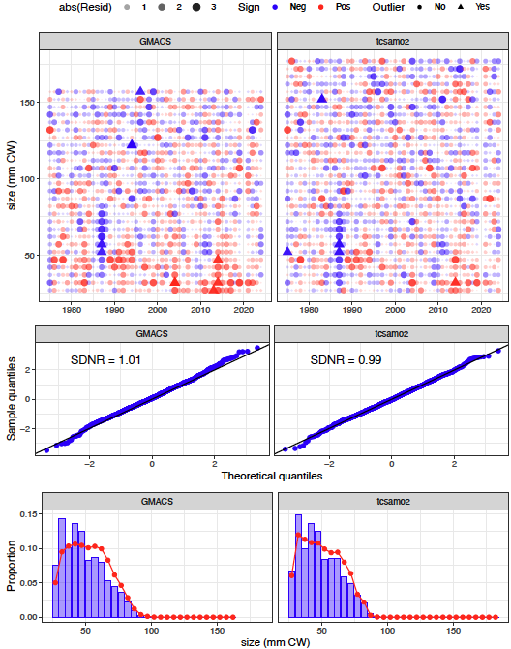
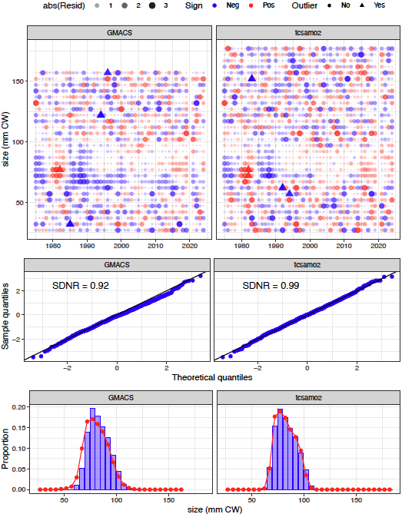
GMACS Models
Immature Females
Mature Females
Notes:
NMFS survey

Slide 21
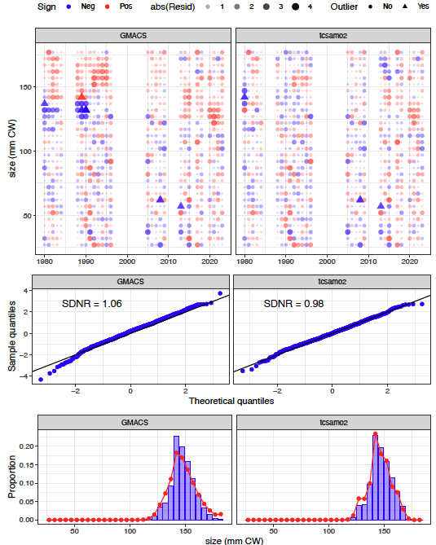
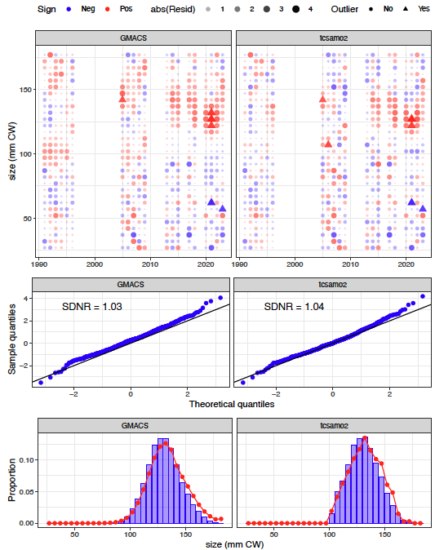
GMACS Models
Notes:
Directed fishery: retained catch (left columns); total catch (right columns)

Slide 22
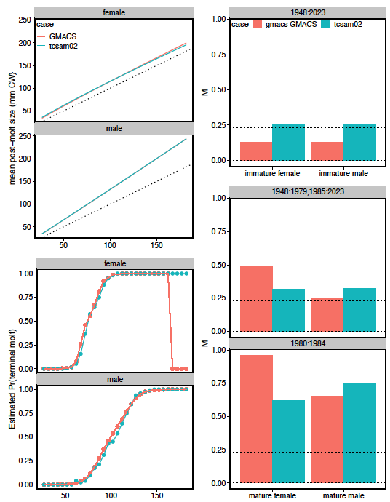
GMACS Models
Notes:
2022

Slide 23
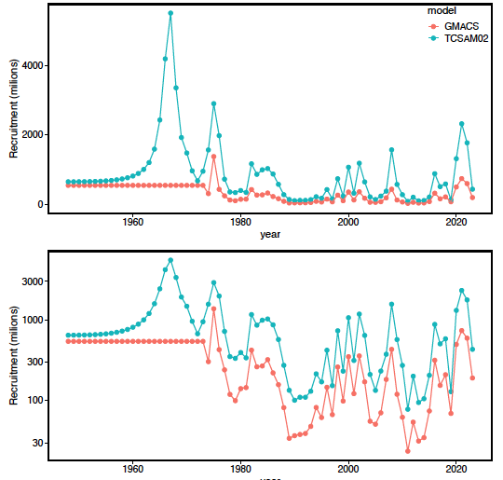
GMACS Models
Notes:
2022

Slide 24
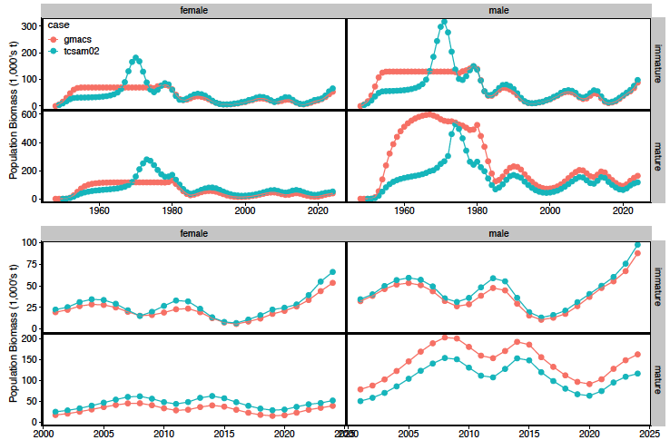
GMACS Models
Notes:
2022

Slide 25
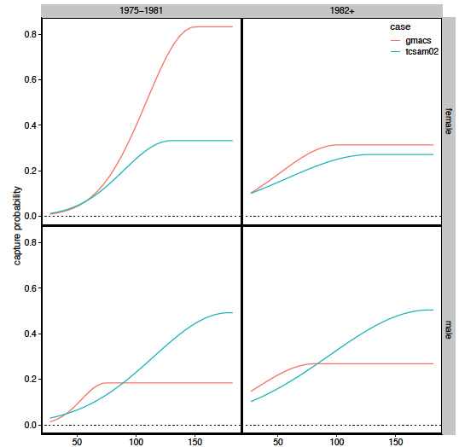
GMACS Models
Notes:
2022

Slide 26
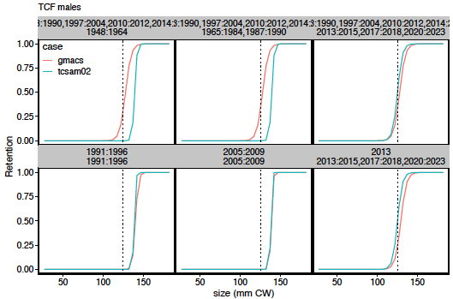
GMACS Models
Notes:
2022

Slide 27
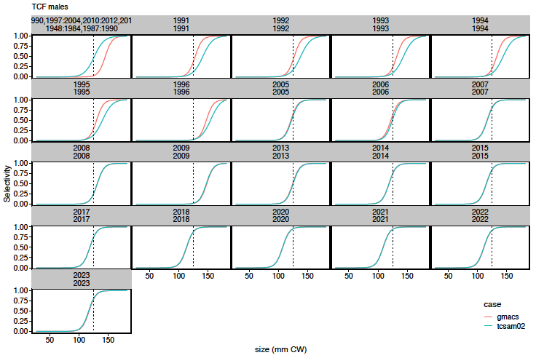
GMACS Models
Notes:
Total catch selectivity curves for directed fishery

Slide 28
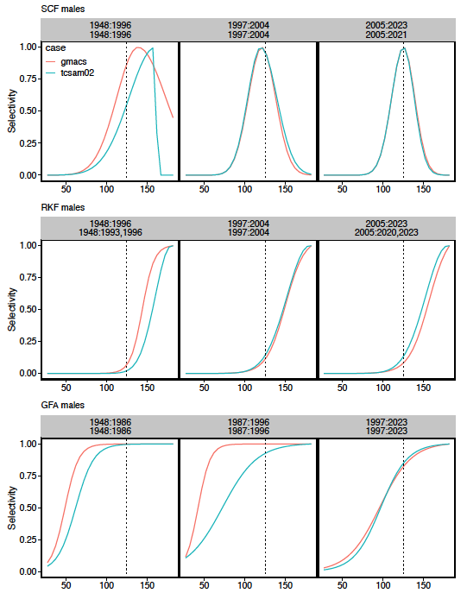
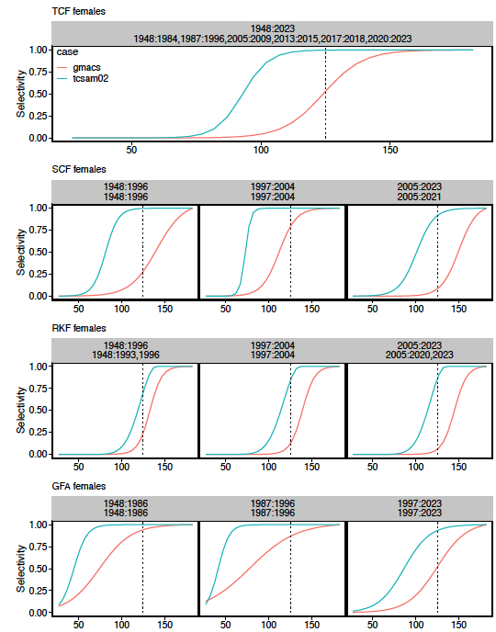
GMACS Models
Notes:
2022

Slide 29
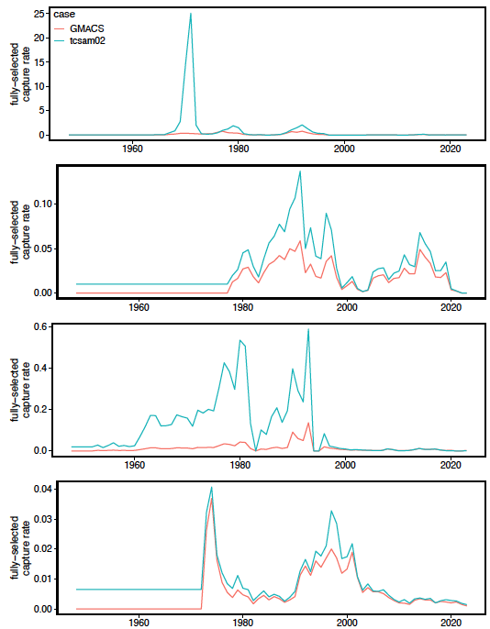
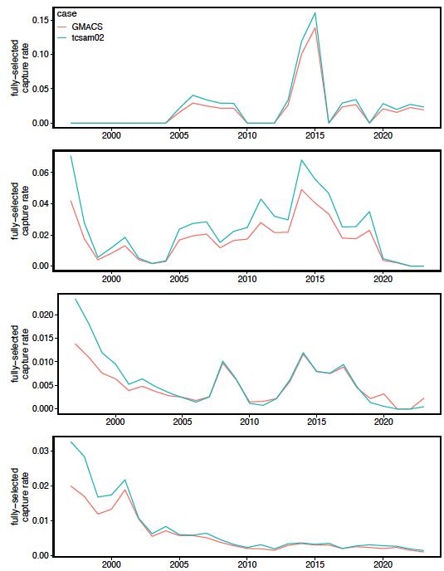
GMACS Models
directed
fishery
snow
crab
BBRKC
Groundfish
Notes:
2022

Slide 30
GMACS Models
Notes:
2022

Slide 31
TCSAM02 Models
Notes:
2022

Slide 32
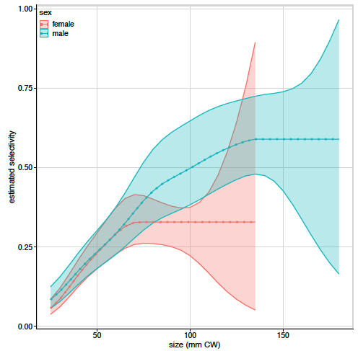
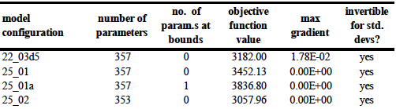
TCSAM02 Models
Used SBS-derived catchability curves for NMFS survey
No tail compression
survey observations
normally-distributed
22.03d5
25_01
25_01a
25_02
357
357
357
353
Notes:
Candidate alternative models

Slide 33
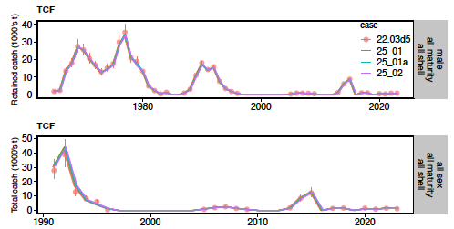
TCSAM02 Models
Notes:
Fits to directed fishery retained and total catch biomass

Slide 34
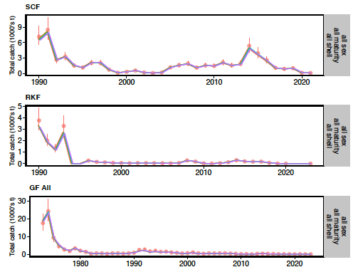
TCSAM02 Models
Notes:
2022

Slide 35
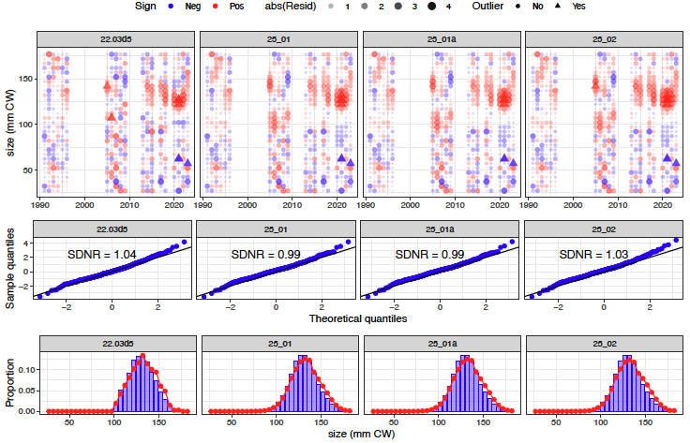
TCSAM02 Models
Notes:
total catch in directed fishery, males

Slide 36
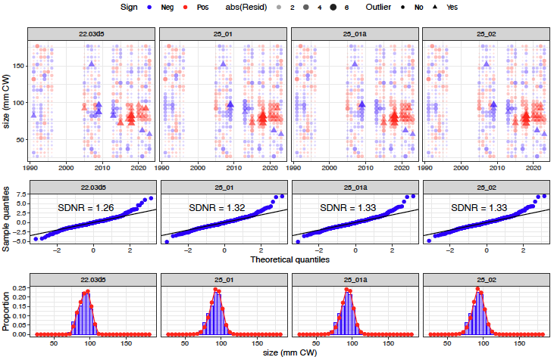
TCSAM02 Models
Notes:
females, directed fisehry total catch

Slide 37
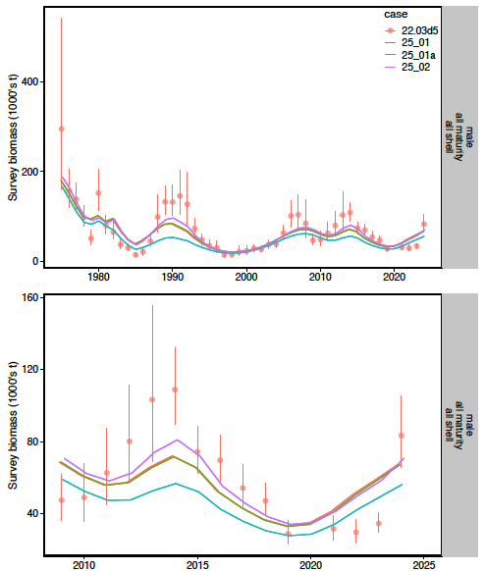
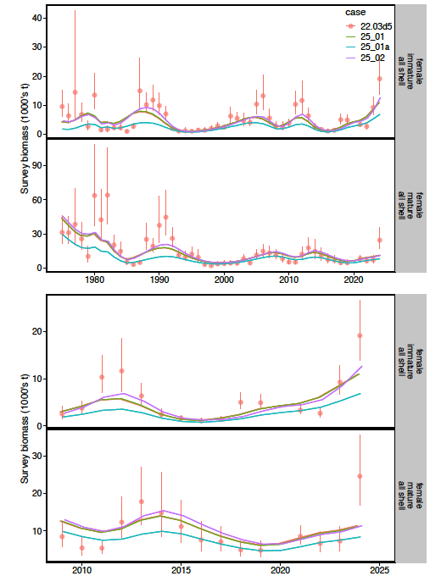
TCSAM02 Models
males
females
Notes:
Fits to survey data

Slide 38
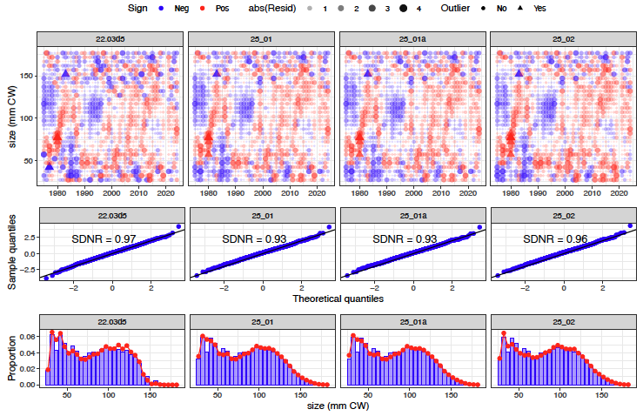
TCSAM02 Models
Notes:
2022

Slide 39
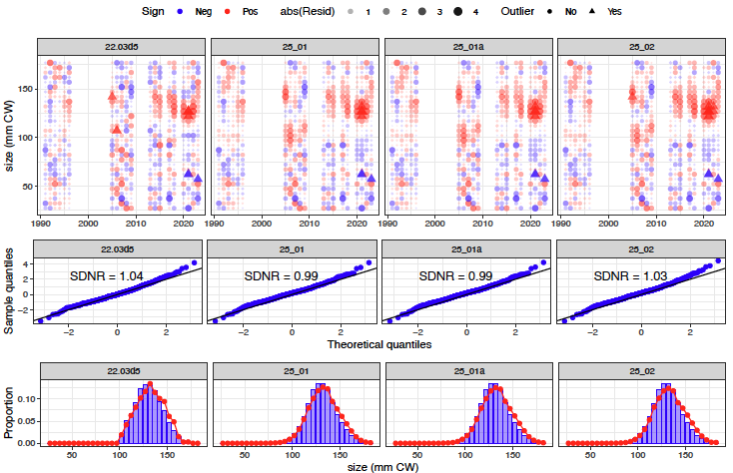
TCSAM02 Models
Notes:
2022

Slide 40
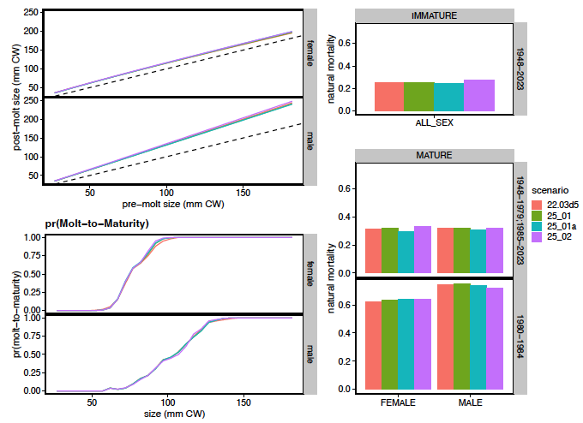
TCSAM02 Models
Notes:
2022

Slide 41
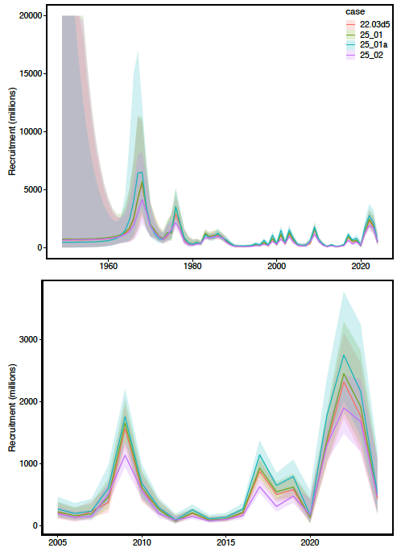
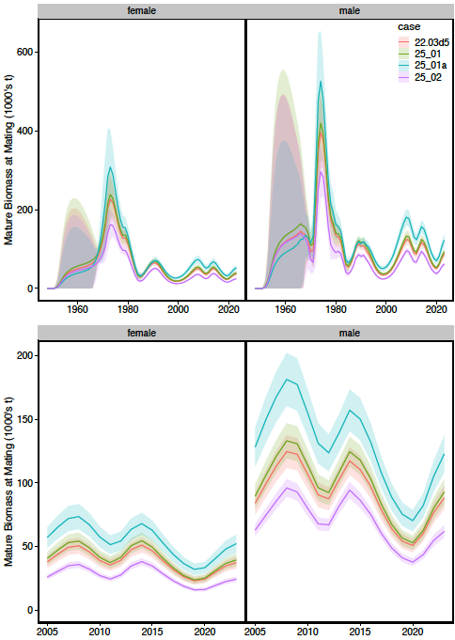
TCSAM02 Models
Recruitment
Mature Biomass
Notes:
2022

Slide 42
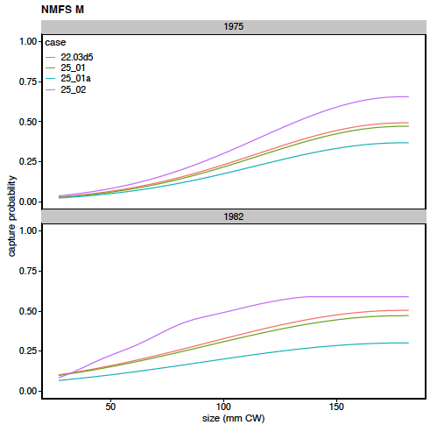
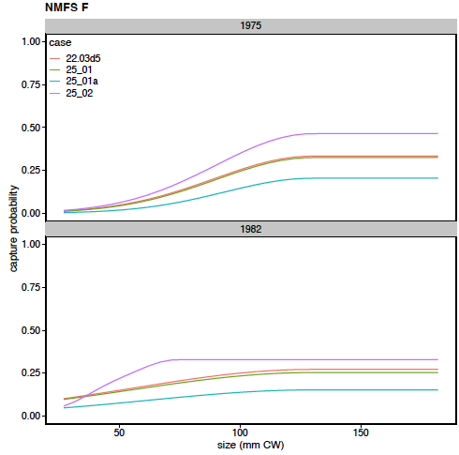
TCSAM02 Models
Notes:
2022

Slide 43
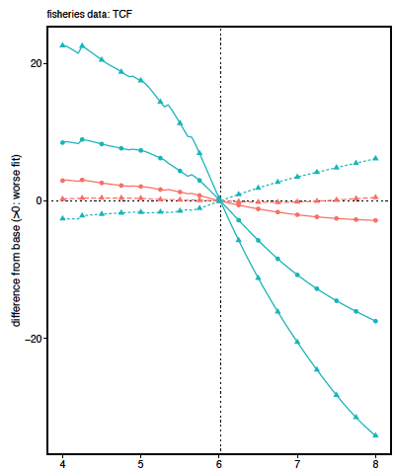
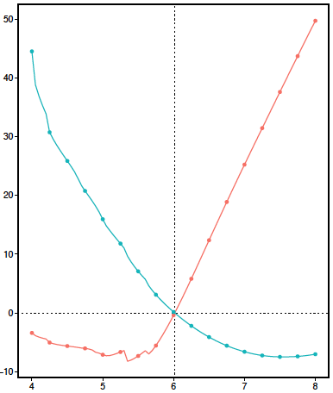
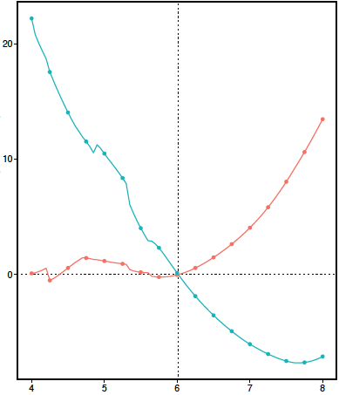
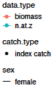
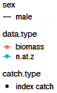
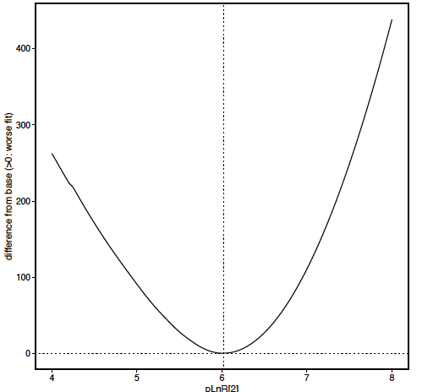
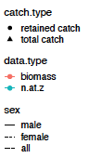
2024 Assessment Model Likelihood Profiles
Directed Fishery
NMFS Survey Females
NMFS Survey Males
Total Likelihood
ln-scale recruitment parameter
Notes:
Likelihood profile results on 2024 assessment model

Slide 44
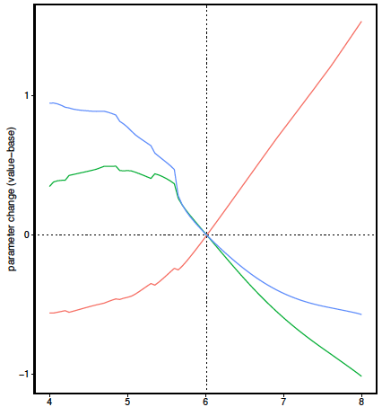
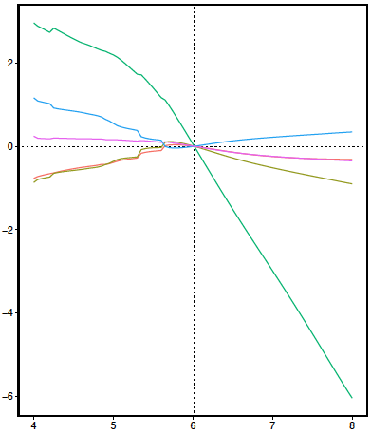






2024 Assessment Model
recruitment parameters
growth parameters
natural mortality parameters
survey catchability parameters
ln-scale recruitment parameter
Notes:
Likelihood profile results on 2024 assessment model

Slide 45
TCSAM02 Models
Notes:
2022

Slide 46
TCSAM02 Models
Notes:
2022

Slide 47
Proposed Tier 3 models for September
2023 assessment model (22.03b) is “base” model
update with 2023/24 fishery/survey data
22.03d recommended as alternative TCSAM02 model
develop model with no parameters at bounds
fix D-M sample size parameter or fit multinomial
G24.03, G24.06 recommended as alternative GMACS models
modify GMACS to specify reference group for initial population size structure
resolve issue with spikes in fishing mortality
add small penalty term to annual devs
provide complete analysis
management quantities,
retrospective patterns, etc
Notes:
2022

Slide 48
Acknowledgments
Scott Goodman: 2018 BSFRF selectivity study data
Andre Punt: GMACS modifications
Kally Spalinger (ADGF): Kodiak Large Mesh trawl survey results
Nathaniel Nichols (ADGG): GOA Tanner crab harvest data
Notes:
2022

